Slide 1
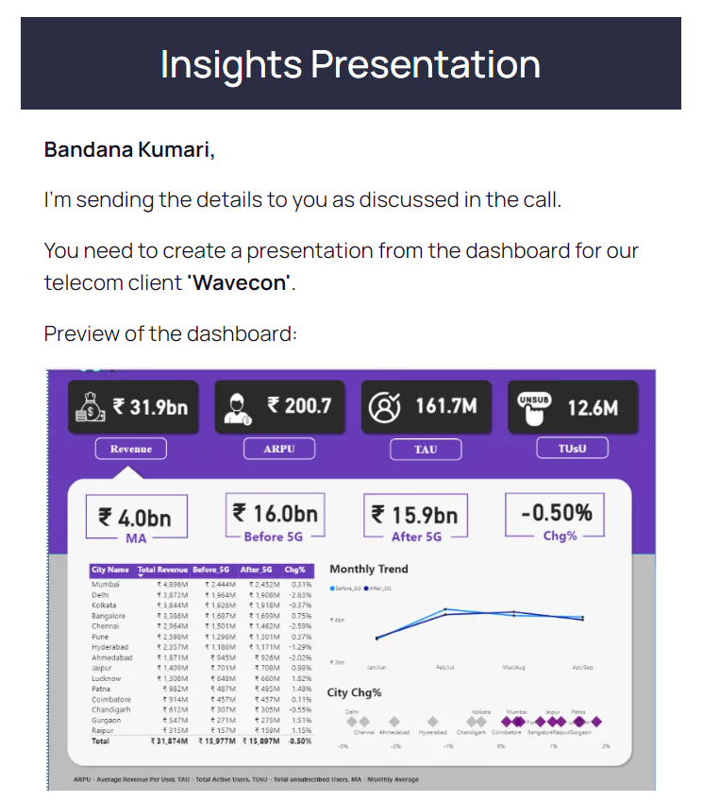
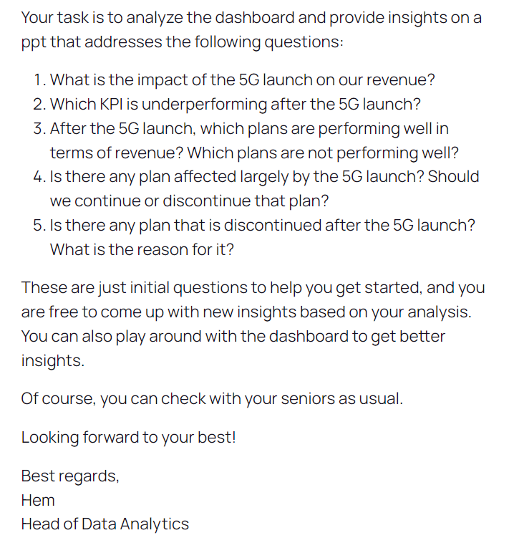

Slide 2


Wavecon Telecom Analysis
Wavecon, a telecommunications provider in India, has introduced its 5G plans.

Slide 3



Data Summary (Year - 2022)
JAN
Before 5G launch
FEB
MAR
APR
MAY
5G Implementation – No data
JUN
JUL
After 5G launch
AUG
SEPT

Slide 4

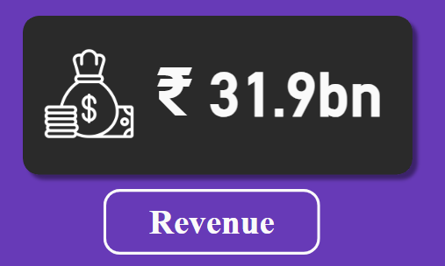
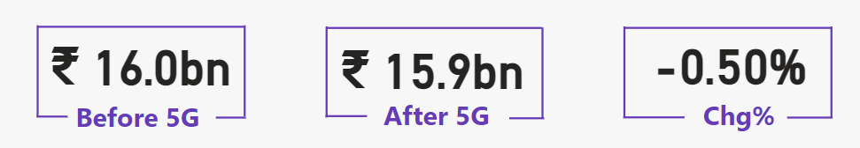
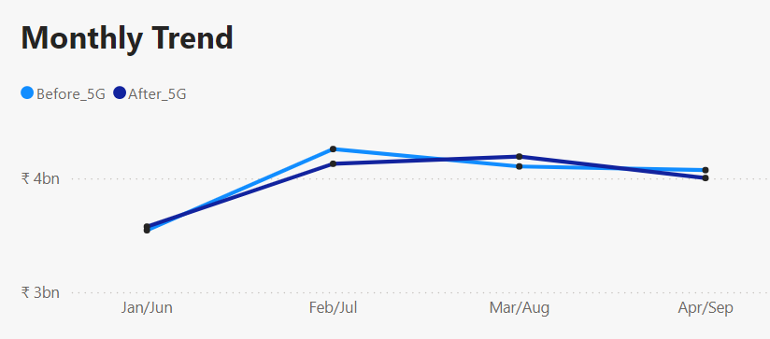
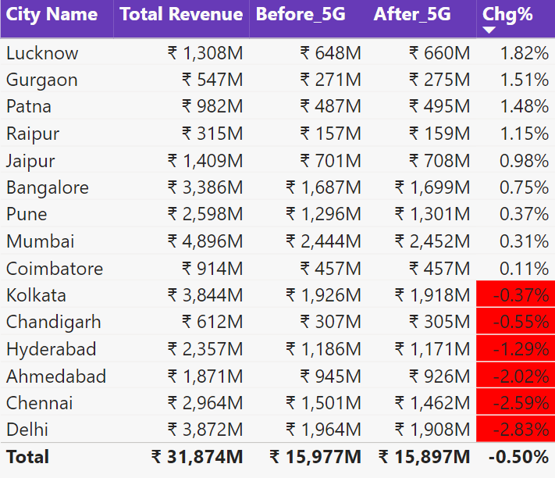
What is the impact of the 5G launch on revenue?
A very thin margin of fluctuations in the revenue compared to the pre-5G launch.
Revenue declined by 0.5% following the launch.
A significant decrease of 2.83% in Delhi.

Slide 5
2. Which KPI is underperforming after the 5G launch?
KPIs :
Revenue
ARPU - Average Revenue Per User
TAU - Total Active Users
TUsU – Total Unsubscribed Users

Slide 6
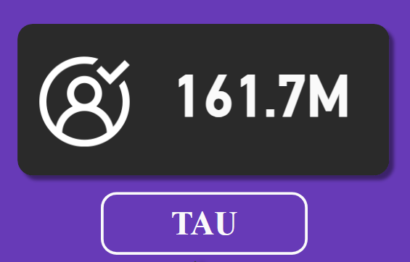
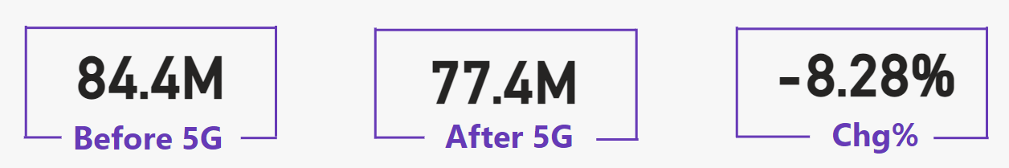
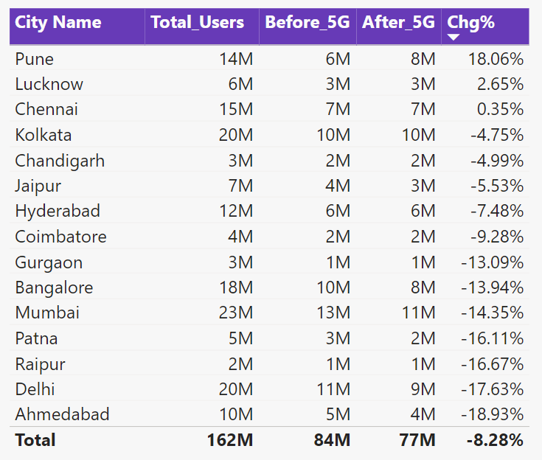
2. Which KPI is underperforming after the 5G launch?
TAU decreased from 84.4M to 77.4M post 5G launch.
Each city might need a unique approach to keep users satisfied with the service after 5G launch.

Slide 7
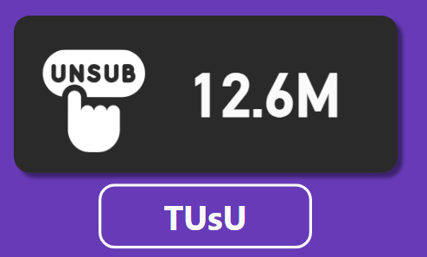
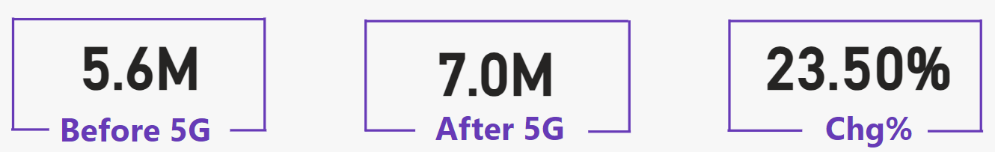
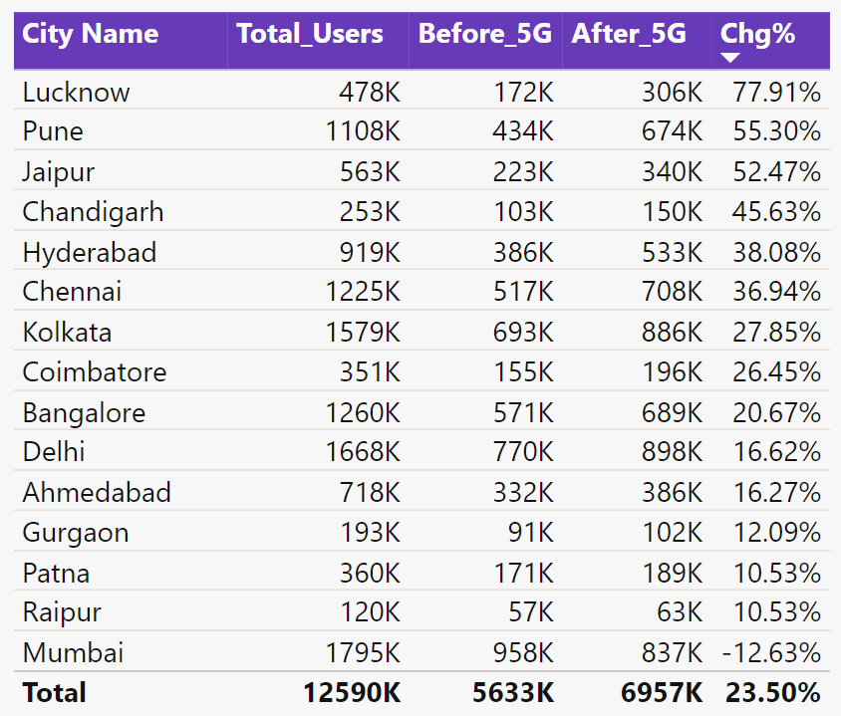
2. Which KPI is underperforming after the 5G launch?
TUsU increased from 5.6M to 7.0M post 5G launch.
Mumbai had a increase of –12.63%

Slide 8
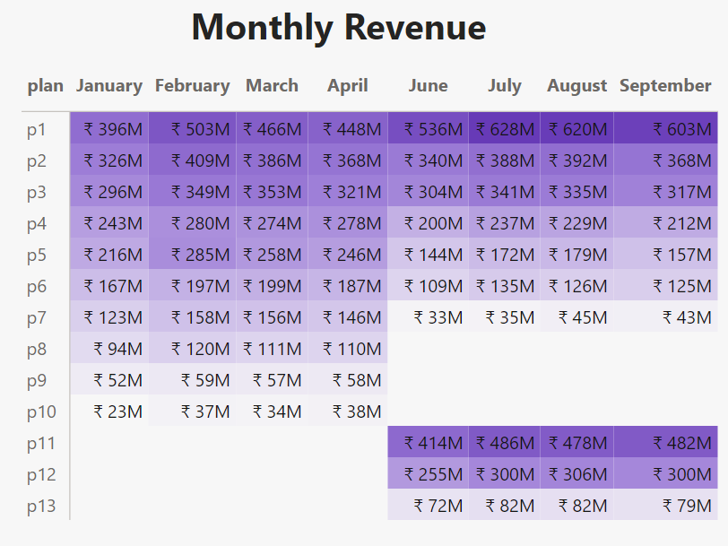
3. After the 5G launch, which plans are performing well terms of revenue?
Which plans are not performing well?
P1,P2,P11 and P12 plan has performed well.
Plans p7 – p13 are underperforming after 5G launch.

Slide 9
PLAN PERFORMANCE
4. Is there any plan affected largely by the 5G? Should we continue or discontinue that plan?
Plan P5 , P6 and P7 has a huge decline in revenue post 5G.
5. Is there any plan that is discontinued after the 5G launch? What is the reason for it?
P8, P9 and P10 are discontinued after 5G launch.

Slide 10
Thank You!!

